Slide 1
Biochemistry
Books:
1. Lehninger Principles of Biochemistry by David L. Nelson and Michael M. Cox, MacMillan publishers
2. Biochemistry by Jeremy M. berg, John L. Tymoczko, Lubert Stryer

Slide 2
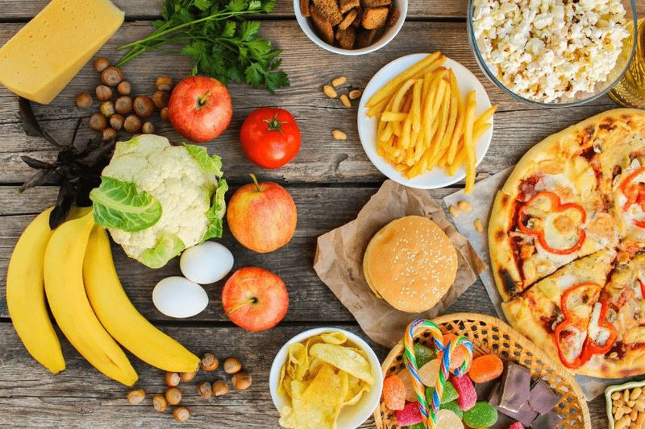
What’s your favourite food ??

Slide 3
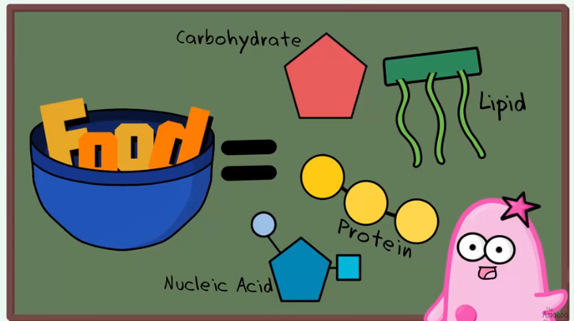
Food is composed of 4 major biomolecules

Slide 4
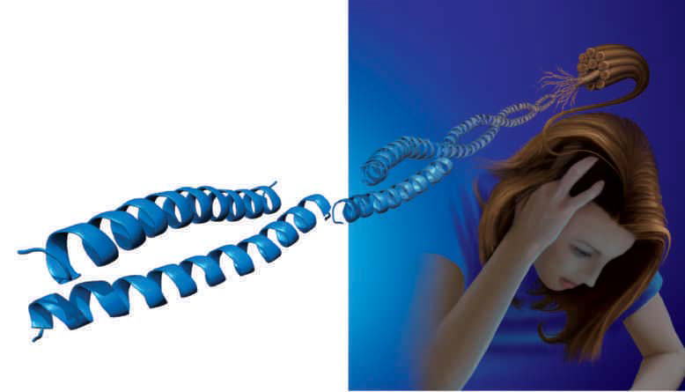
Introduction to Macromolecules

Slide 5
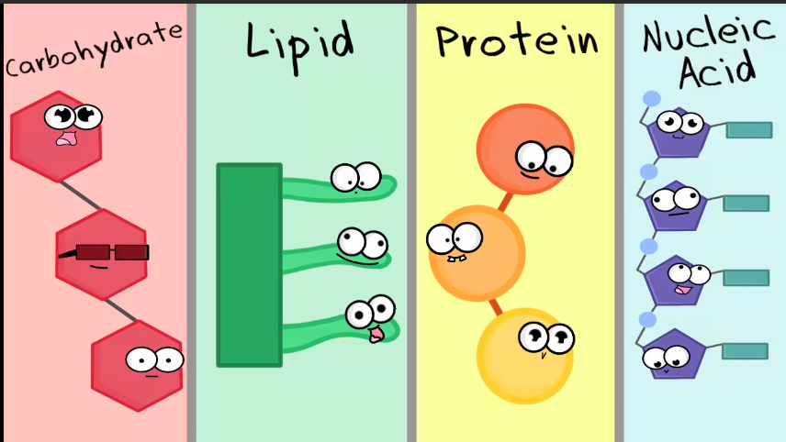

Slide 6
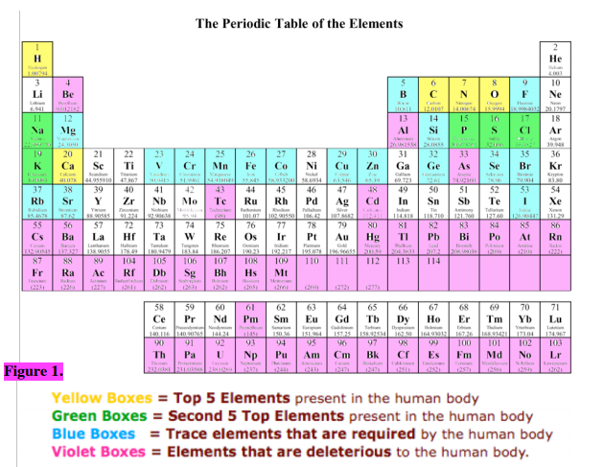
Main elements of life

Slide 7
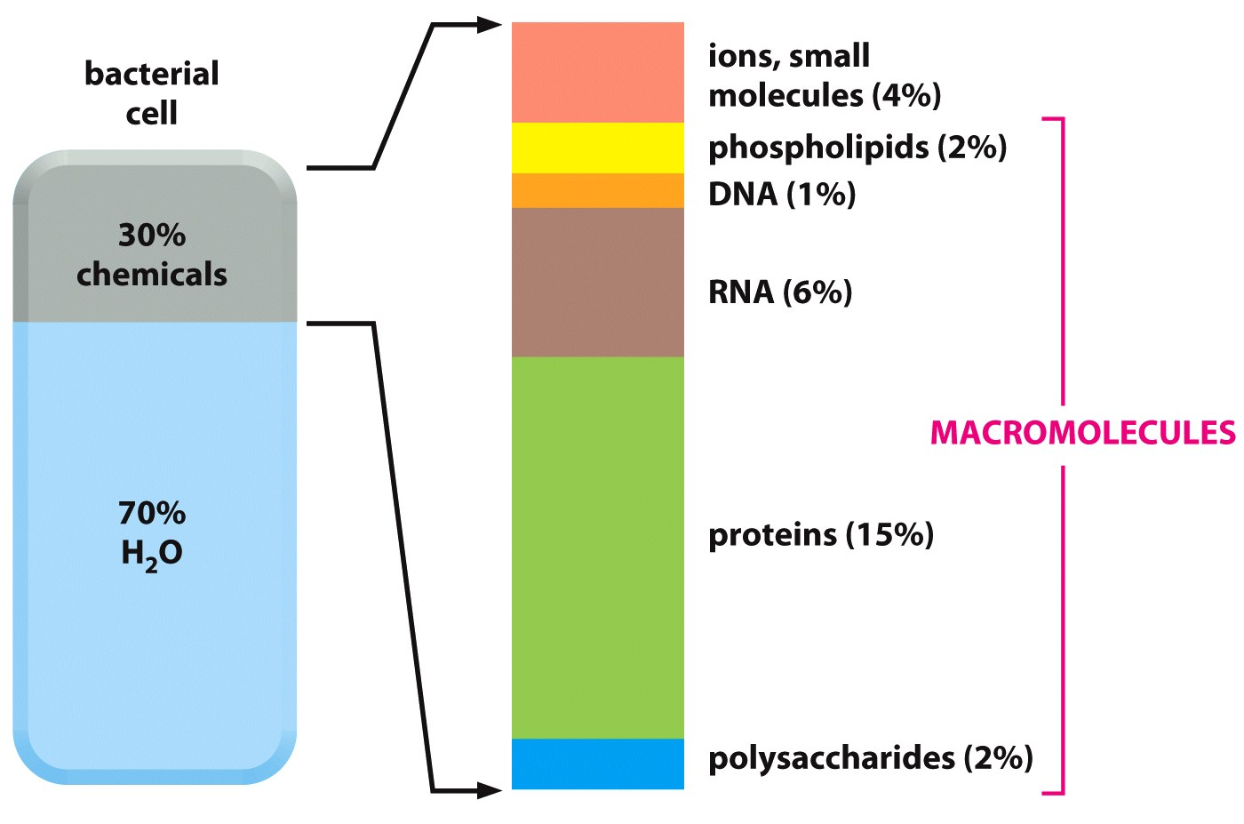
Majority of the organic mass is contributed by macromolecules

Slide 8
What are we going to study ?
What are these macromolecules?
Why are they important ?
Metabolism ?

Slide 9
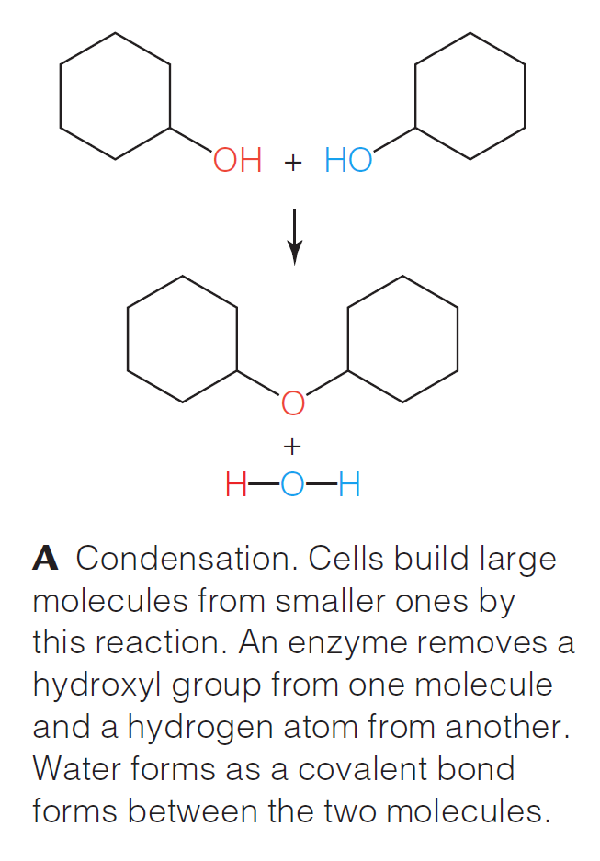
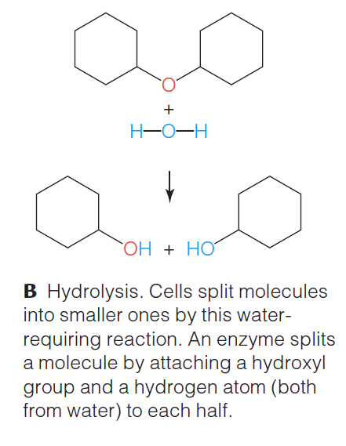
Condensation and hydrolysis are two key reactions in metabolism

Slide 10
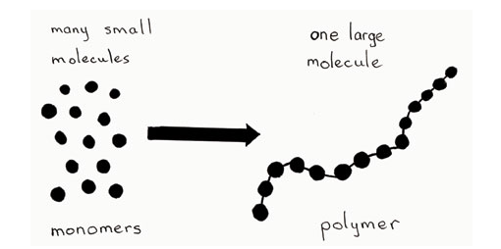
What is common in all macromolecules ?
Monomers-Building Blocks
**Macromolecules are also known as polymers

Slide 11
Macromolecules and their building blocks
Carbohydrates
Monosaccharides
Lipids
Fatty Acids, Glycerols
Proteins
Nucleic Acids
Amino acids
Nucleotides
Nucleic Acids

Slide 12
Carbohydrates

Slide 13
What are carbohydrates (or Saccharides)?
Commonly known as Sugars. (In Greek Sakcharon meaning "Sugar").
Carbohydrates are aldehyde (H-C=O) or ketone (C=O) compounds with multiple hydroxyl groups.
They make up most of the organic matter on Earth because of their extensive roles in all forms of life.
Carbohydrates provide energy.
They are the best source of fuel for the body.
Carbohydrates also help to digest protein and fat.
If we eat more carbohydrates than are needed for energy, the extra is stored in the liver or in the tissues as fat.

Slide 14
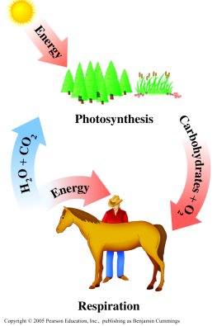
Carbohydrates
Produced by photosynthesis in plants.
The major source of energy from our diet.
Composed of the elements C, H, and O in 1:2:1 ratio.
C_{n}(H₂O)_{n}
Photosynthesis
6CO₂ + 6H₂O + energy C₆H₁₂O₆ + 6O₂
Respiration
glucose

Slide 15
Types of Carbohydrates
H⁺ or enzyme
1. Monosaccharide + H₂O no hydrolysis
2. Disaccharide + H₂O two monosaccharide units
H⁺ or enzyme
+
H⁺ or enzyme
3. Oligosaccharide + many H₂O 2-10 monosaccharide units
4. Polysaccharide + many H₂O >10 monosaccharide units
H⁺ or enzyme

Slide 16
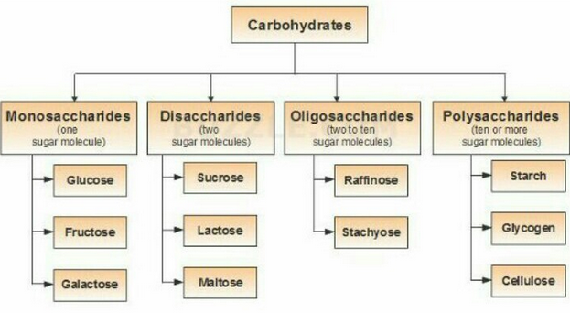
Common Carbohydrates
Ribose
Deoxyribose

Slide 17
Monosaccharides (Simple Sugar)
A carbohydrate that cannot be split or hydrolyzed into smaller carbohydrates.
Monosaccharides are carbohydrates with:
The simplest carbohydrates
3-9 carbon atoms
A carbonyl group (aldehyde or ketone)
Several hydroxyl groups
C_{n}(H₂O)_{n}
C_{n}H_{2n}O_{n}
║
C ─ H
│
H─ C ─ OH
│
H─ C ─ OH
│
CH₂OH
O

Slide 18
Monosaccharides – Aldose & Ketose
Aldose is monosaccharide:
With an aldehyde group and many hydroxyl (-OH) groups.
“Aldo-” + suffix
Ketose is monosaccharide:
With a ketone group and many hydroxyl (-OH) groups.
“Keto-” + suffix
O
║
C ─ H aldose
│
H─ C ─ OH
│
H─ C ─ OH
│
CH₂OH
CH₂OH
│
C = O ketose
│
H─ C ─ OH
│
H─ C ─ OH
│
H ─C ─ OH
│
CH₂OH
1
2
1
triose (3C atoms)
tetrose (4C atoms)
pentose (5C atoms)
hexose (6C atoms)
an aldotetrose
(Erythose)
a ketohexose
(Fructose)

Slide 19
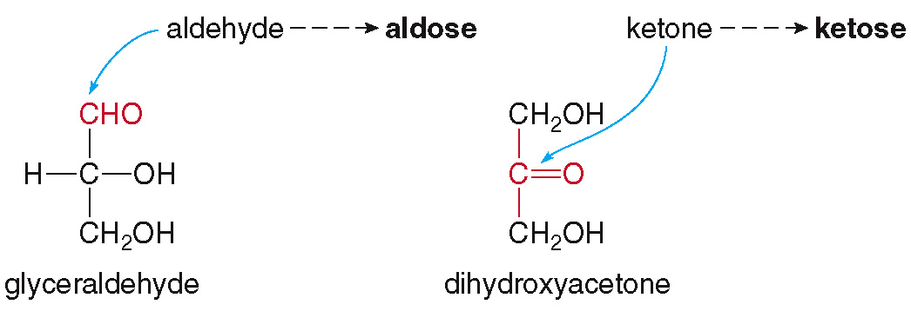
Monosaccharides (Simple Sugar)
The simplest aldose is glyceraldehyde.
The simplest ketose is dihydroxyacetone.
C₃H₆O₃
C₃H₆O₃
Constitutional Isomers

Slide 20
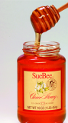
Some important Monosaccharides
Glucose (Dextrose)
(C₆H₁₂O₆, aldohexose) – Blood sugar
The most abundant monosaccharide
Is found in fruits, vegetables, corn syrup, and honey.
Is found in disaccharides such as sucrose, lactose, and maltose.
Makes up polysaccharides such as starch, cellulose, and glycogen.

Slide 21
Some important Monosaccharides
Fructose
(C₆H₁₂O₆, ketohexose)
Is the sweetest of the carbohydrates.
Is found in fruit juices and honey (fruit sugar).
In bloodstream, it is converted to its isomer, glucose.
Is bonded to glucose in sucrose (a disaccharide known as table sugar).

Slide 22
Some important Monosaccharides
Galactose
(C₆H₁₂O₆, aldohexose),
Has a similar structure to glucose except for the –OH on Carbon 4.
Cannot find in the free form in nature.
Exist in the cellular membranes of the brain and nervous system.
Combines with glucose in lactose (a disaccharide and a sugar in milk).

Slide 23
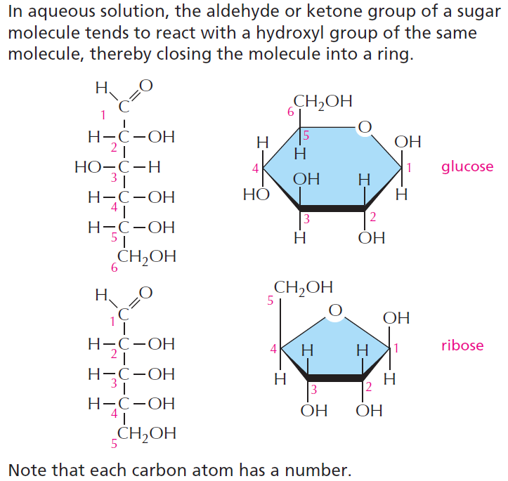
Sugar molecules tend to make a ring structure in water

Slide 24
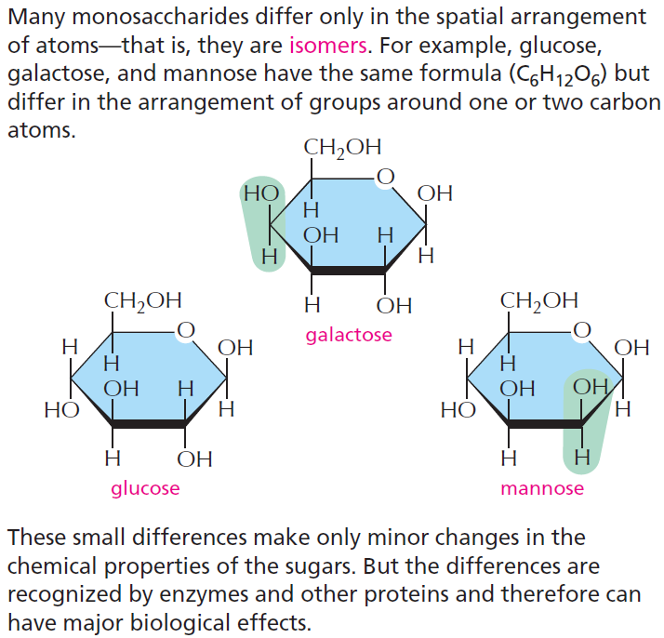
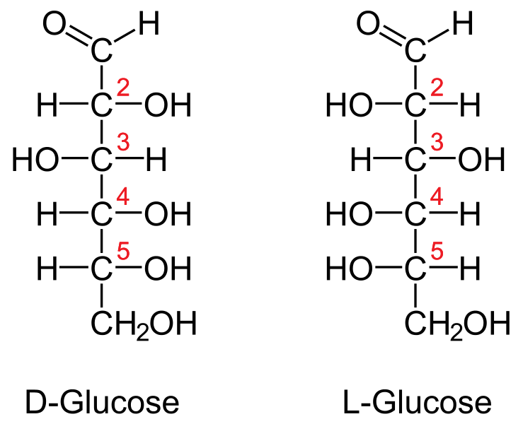
Isomers and stereoisomers
Sets of molecules with the same chemical formula but different structures are called isomers, and mirror-image pairs of such molecules are called optical isomers or stereoisomers. Isomers are widespread among organic molecules in general, and they play a major part in generating the enormous variety of sugars.
Stereoisomers of glucose

Slide 25
Physical properties of Monosaccharides
Colorless
Sweet
Crystalline solids
Polar with high melting points (because of -OH groups)
Soluble in water and insoluble in nonpolar solvents
(H-bond because of OH groups)

Slide 26
Disaccharides
A disaccharide:
Consists of two monosaccharides linked by a glycosidic bond (when one –OH group reacts with another –OH group).
A glycosidic bond is a covalent bond that joins a carbohydrate to another functional group or molecule.
Glucose + Glucose Maltose + H₂O
Glucose + Galactose Lactose + H₂O
Glucose + Fructose Sucrose + H₂O
REDUCING
SUGAR
NON-REDUCING
SUGAR
Notes:
The orientation of the bond may be noted, too. α- and β-glycosidic bonds are based on the stereocenter furthest from saccharide C1. An α-glycosidic bond occurs when both carbons share the same stereochemistry. Β-glycosidic bond forms when the two carbons have different stereochemistry.

Slide 27
Reducing sugar
A reducing sugar is any sugar that is capable of acting as a reducing agent because it has a free aldehyde group or a free ketone group.
All monosaccharides are reducing sugars !
Among Disaccharides, Maltose and Lactose are reducing sugars. They have only one of their two anomeric carbons involved in the glycosidic bond, meaning that they can convert to an open-chain form with an aldehyde group.
Sucrose is a NON-REDUCING sugar. Because it has glycosidic bonds between the anomeric carbons and thus cannot convert to an open-chain form with an aldehyde group; It’s stuck in the cyclic form.

Slide 28
Disaccharides
Maltose:
Is a disaccharide of two glucose molecules.
Has a α -1,4-glycosidic bond (between two α-glucoses).
Is obtained from the breakdown of starches.
Is used in cereals and candies.
Is a reducing sugar (carbon 1 can open to give a free aldehyde to oxidize).
α -1,4-glycosidic
bond
β
1
+
4
1
4
+ H₂O
α-glucose
α-glucose
Maltose

Slide 29
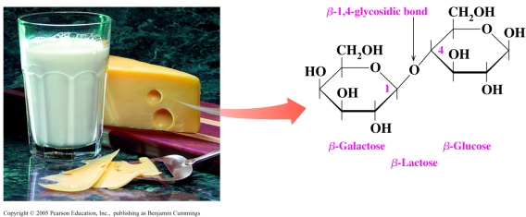
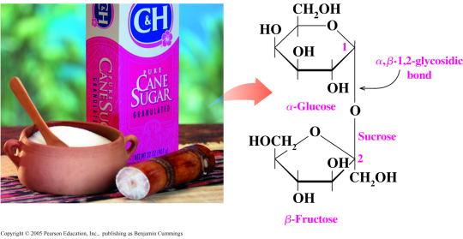
Disaccharides
Lactose:
Is a disaccharide of galactose and glucose.
Has a β -1,4-glycosidic bond (between β-galactose and α-gulcose).
Is found in milk and milk products (almost no sweet).
Is a reducing sugar (carbon 1 can open to give a free aldehyde to oxidize).
Lactose

Slide 30
Disaccharides
Sucrose:
Is found in table sugar (obtained from sugar cane and sugar beets).
Consists of glucose and fructose.
Has an α,β-1,2-glycosidic bond (between α-glucose and β-fructose).
Is not a reducing sugar (carbon 1 cannot open to give a free aldehyde to oxidize).
β-1,2-glycosidic
bond

Slide 31
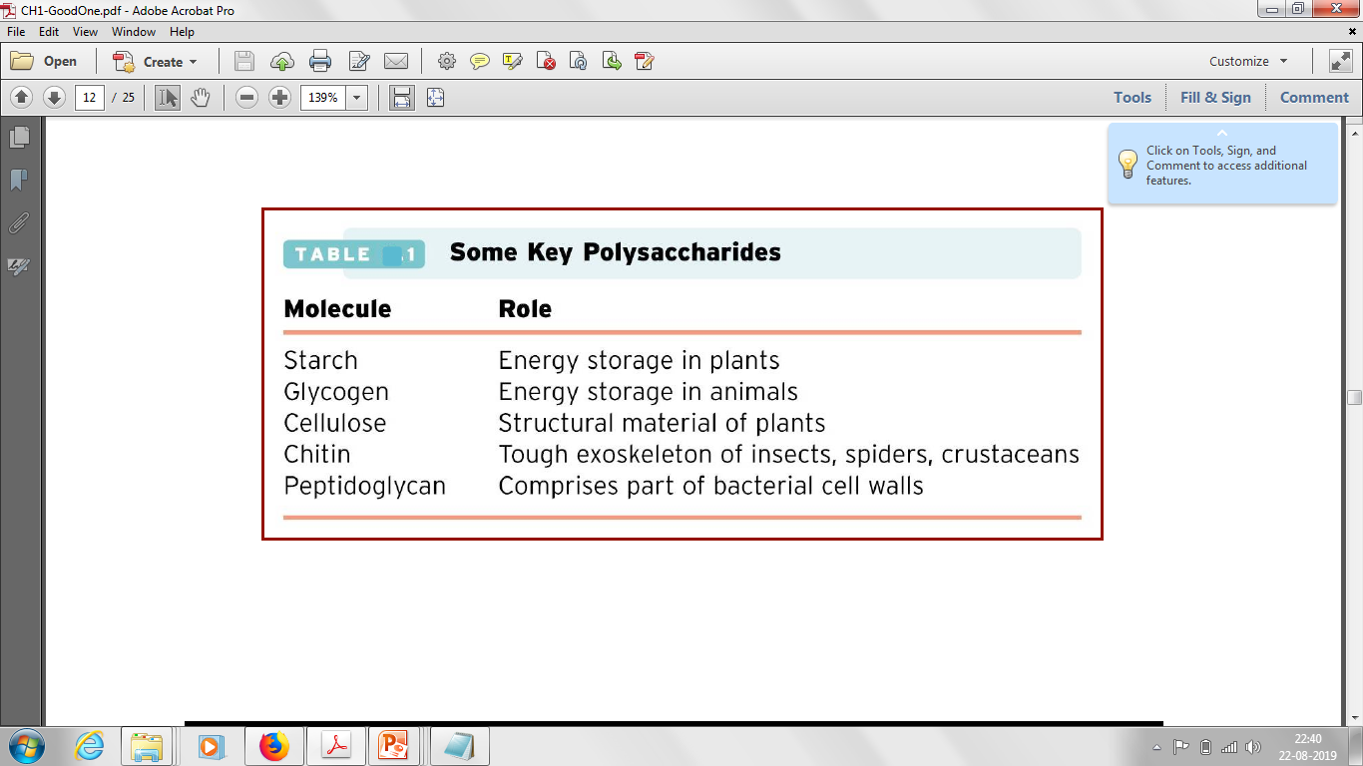
Polysaccharides
Polymers of many monosaccharides units.
Some of the important Polysaccharides are:
Homopolysaccharides contain only a single type of monomer;
Heteropolysaccharides contain two or more different kinds
Notes:
Starch and glycogen serve as short-term energy stores in plants and animals, respectively.

Slide 32
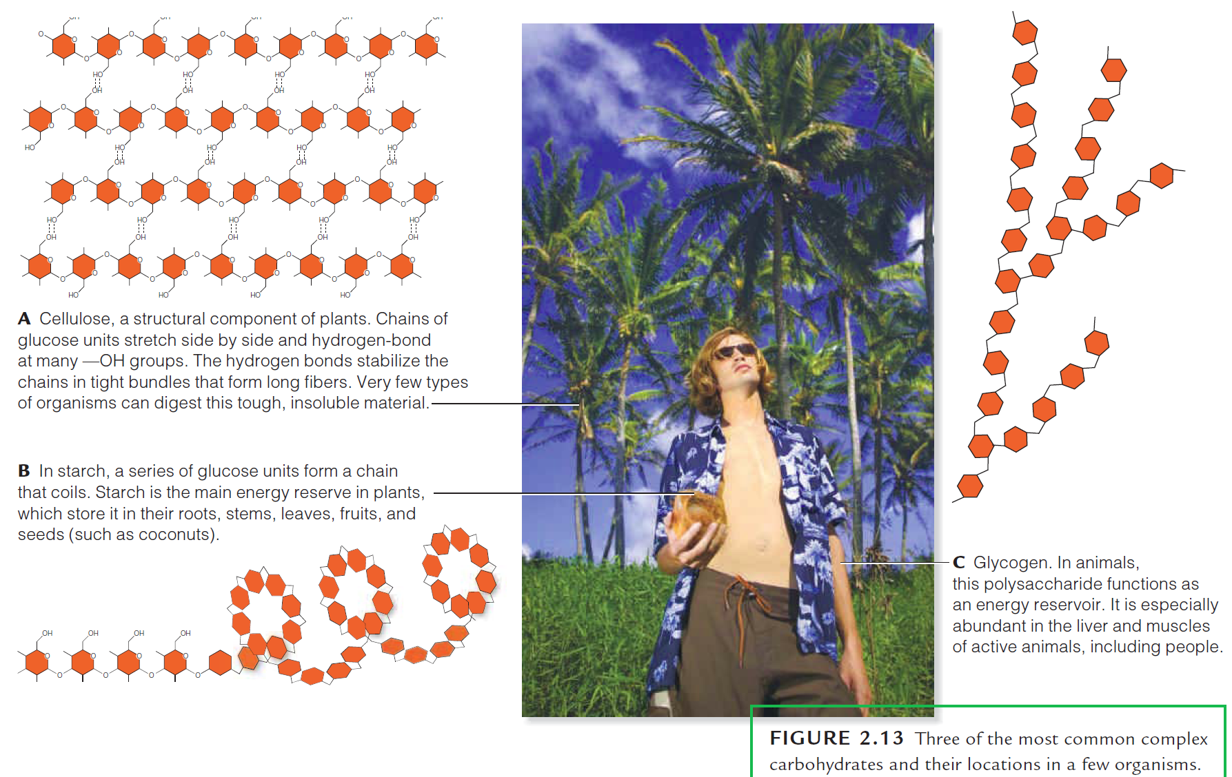
Complex carbohydrates are water insoluble

Slide 33
Polysaccharides
Starch:
Starch is a glucose polymer in which glucose units are bonded by α-linkages.
Amylose consists of a linear chain of several hundred glucose molecules and Amylopectin is a branched molecule made of several thousand glucose units .
Starches are insoluble in water.
They can be digested by breaking the α-linkages (glycosidic bonds).
Both humans and other animals have amylases, so they can digest starches.
Potato, rice, wheat, and maize are major sources of starch in the human diet.
Amylose (15-20%)
Starch
Amylopectin (80-85%)

Slide 34
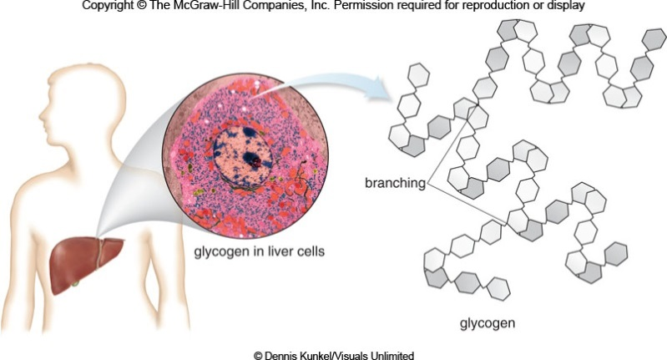
Polysaccharides
Glycogen:
It is similar to amylopectin (more highly branched-every 10-15 units).
It is an energy storage molecule found in animals/humans.
It is stored mainly in the liver and in muscle cells.
When glucose is needed for energy, glucose units are hydrolyzed from the ends of the glycogen polymer.
Because glycogen is highly branched, there are many ends available for hydrolysis.

Slide 35
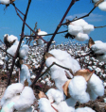
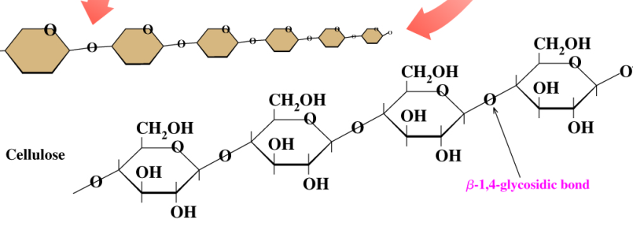
Polysaccharides
Cellulose:
Is a polysaccharide of glucose units in unbranched chains with β-1,4-glycosidic bonds (2200 glucose units).
Has rigid structure (H-bond) and insoluble in water.
Is the major structural material of wood & plants (cotton: 100%).
Cannot be digested by humans because of the β-1,4-glycosidic bonds (needs an enzyme: β-glycosidase).

Slide 36
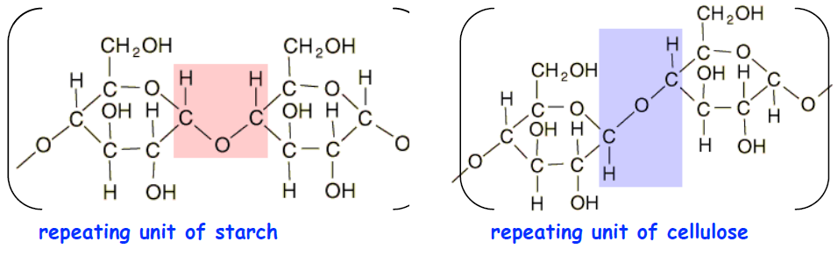
Difference in the structure of Starch and Cellulose
Starch and cellulose are both polymers of glucose. They differ only in
whether the connecting oxygen atom points down as in starch or up as in cellulose.
Cellulose and starch illustrate the principle that structure affects function in biological systems.

Slide 37
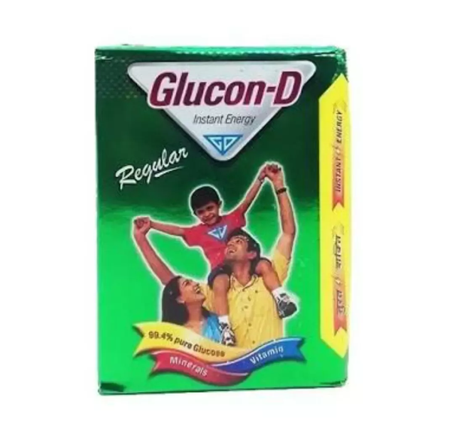
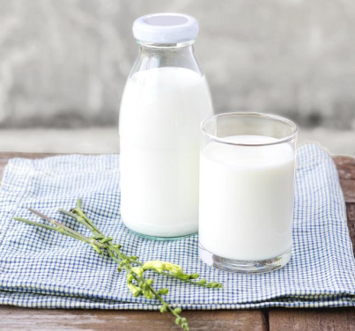
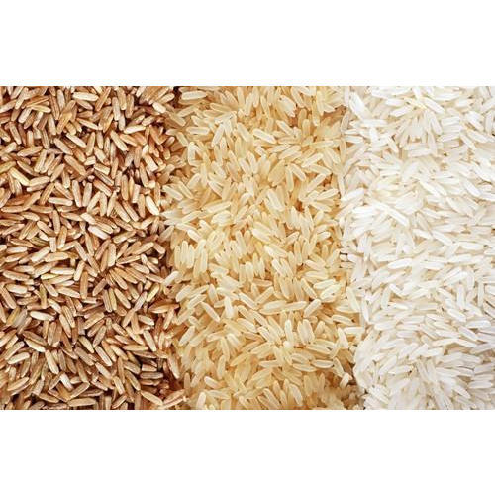
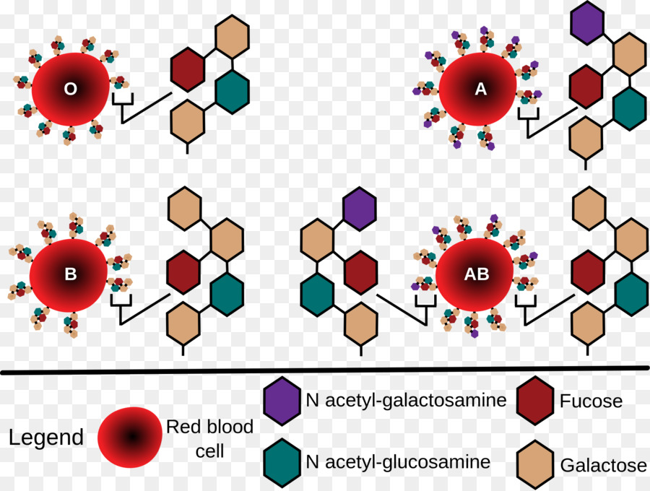
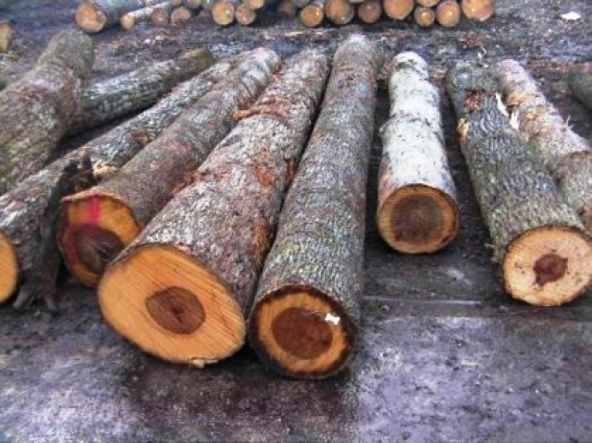
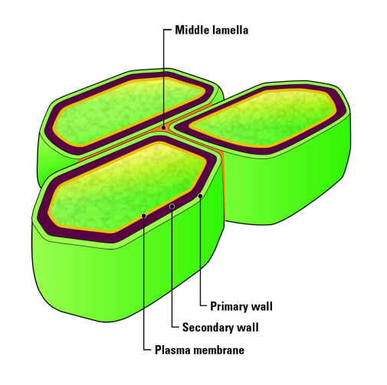
Some functions of carbohydrates
Source of energy
Storage form of energy:
Lactose
Starch
D-glucose
Cell recognitions:
Structural component:
cellulose
Glycolipids and glycoproteins

Slide 38
Why are they important ?
First, carbohydrates serve as energy stores, fuels, and metabolic intermediates.
Second, ribose and deoxyribose sugars form part of the structural framework of RNA and DNA.
Third, polysaccharides are structural elements in the cell walls of bacteria and plants. In fact, cellulose, the main constituent of plant cell walls, is one of the most abundant organic compounds in the biosphere.
Fourth, carbohydrates are linked to many proteins and lipids, where they play key roles in mediating interactions among cells and interactions between cells and other elements in the cellular environment.

Slide 39
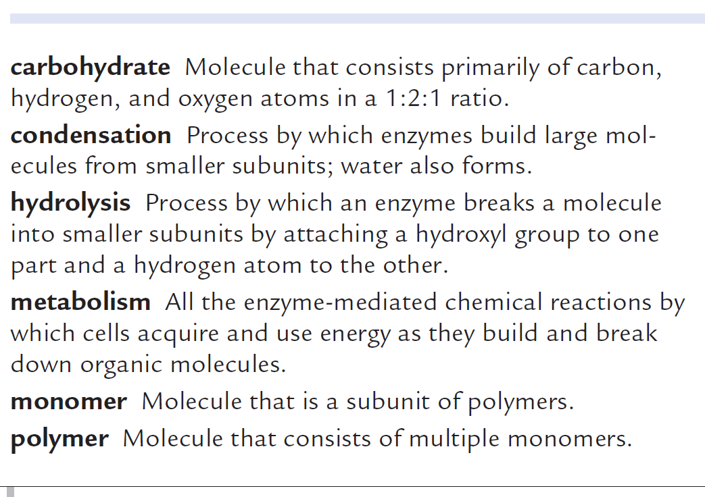
Summary Points

Slide 40
Lipids

Slide 41
What are Lipids ?
Lipids are fatty, oily, or waxy organic compounds.
Lipids are water insoluble biomolecules that are highly soluble in organic solvents such as chloroform.
Composed of fatty acids and glycerols.

Slide 42
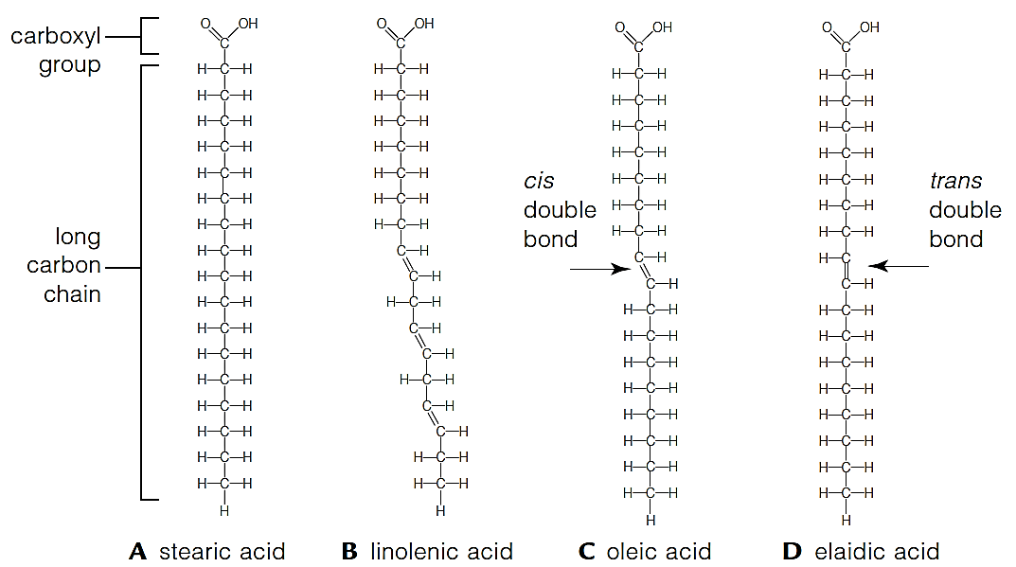
Lipids
Many lipids incorporate fatty acids, small organic compounds that consist of a long carbon chain with an acidic carboxyl group at one end.

Slide 43
Lipids
Alcohol
Fats are lipids with one, two, or three fatty acids that dangle like tails from a small alcohol called glycerol.
Fatty acid
Fatty acid
Fatty acid

Slide 44
Lipids are fatty, oily or waxy
It depends on the fatty acid it contains
Saturated
Unsaturated

Slide 45
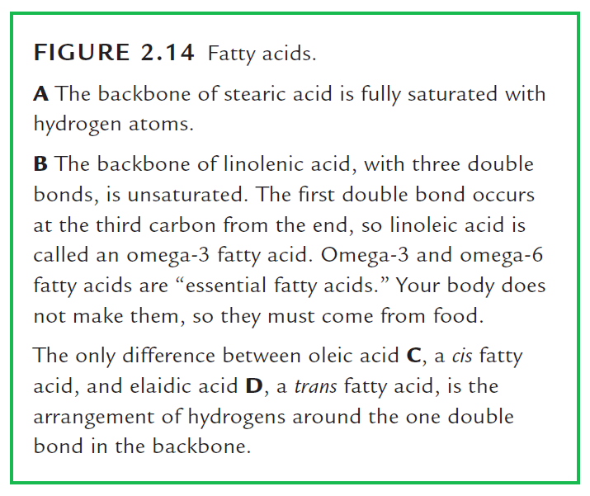

Slide 46
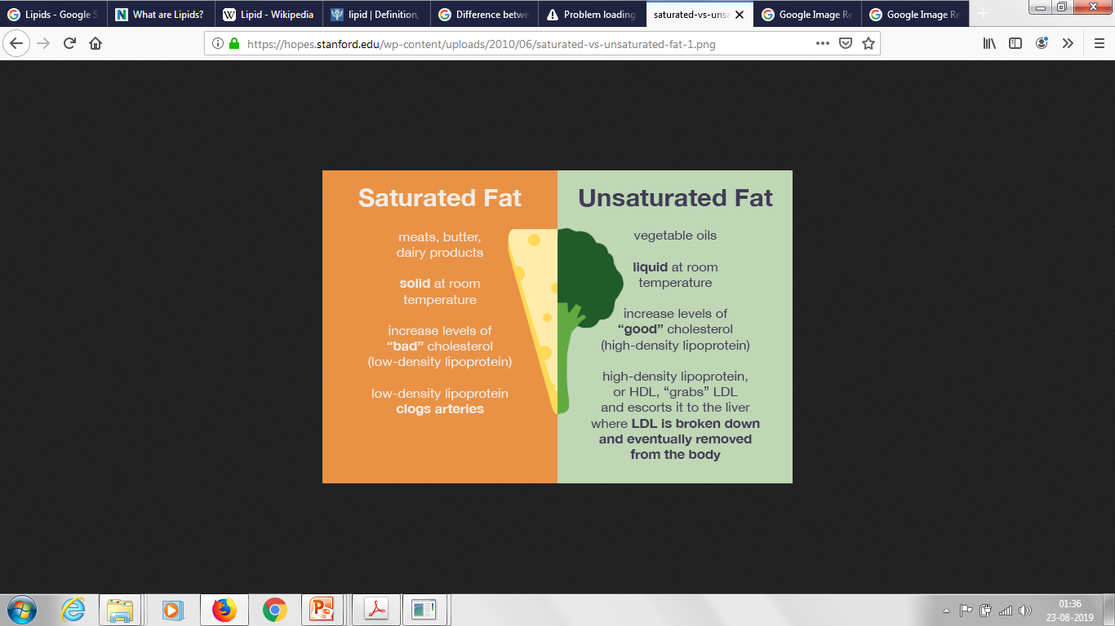
Notes:
Fluidity of fats depend on the length and saturation of the fatty acid chains

Slide 47
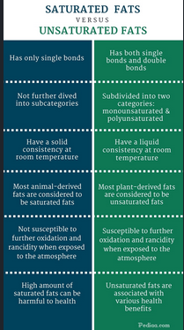

Slide 48
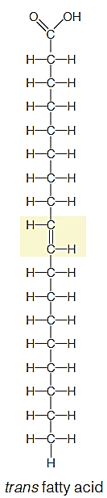
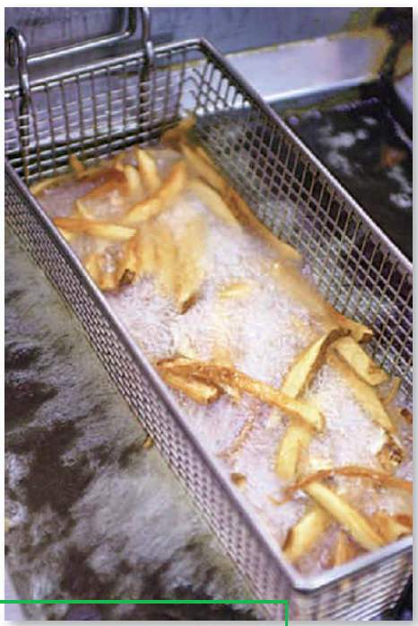
Partially hydrogenated vegetable oils
With hydrogenation, liquid vegetable oil turns into a semi-solid or solid fat.
Although trans fats are edible, consuming trans fats has been shown to
-increase the risk of coronary artery disease
-by raising levels of low-density lipoprotein (LDL or "bad cholesterol"), and
-lowering levels of high-density lipoprotein (HDL or "good cholesterol")

Slide 49
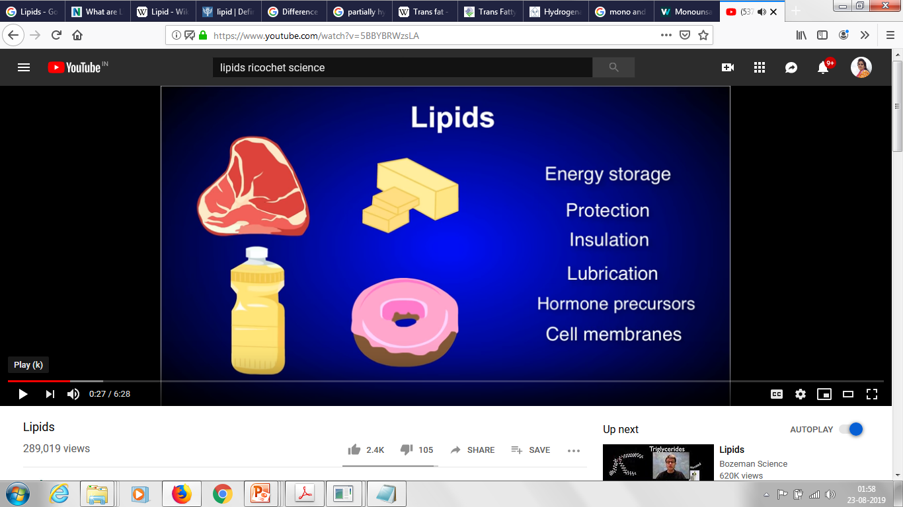
Functions of Lipids
Notes:
they serve as fuel molecules, highly concentrated energy stores, signal molecules, and components of membranes.

Slide 50
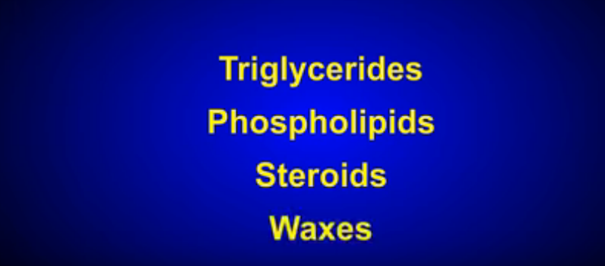
Category of Lipids

Slide 51
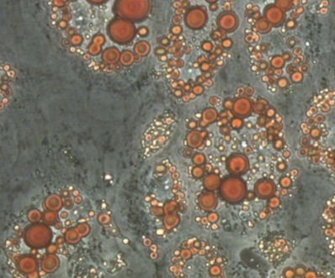
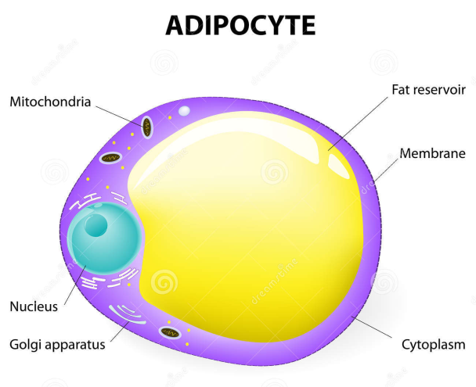
Triglycerides
Most neutral fats, including butter and vegetable oils, have three fatty acid tails, so they are called triglycerides.
Triglycerides are the most abundant and richest energy source in vertebrate bodies.
They are concentrated in adipose tissue that insulates and cushions body parts.
Alcohol
Fatty acid
Fatty acid
Fatty acid

Slide 52
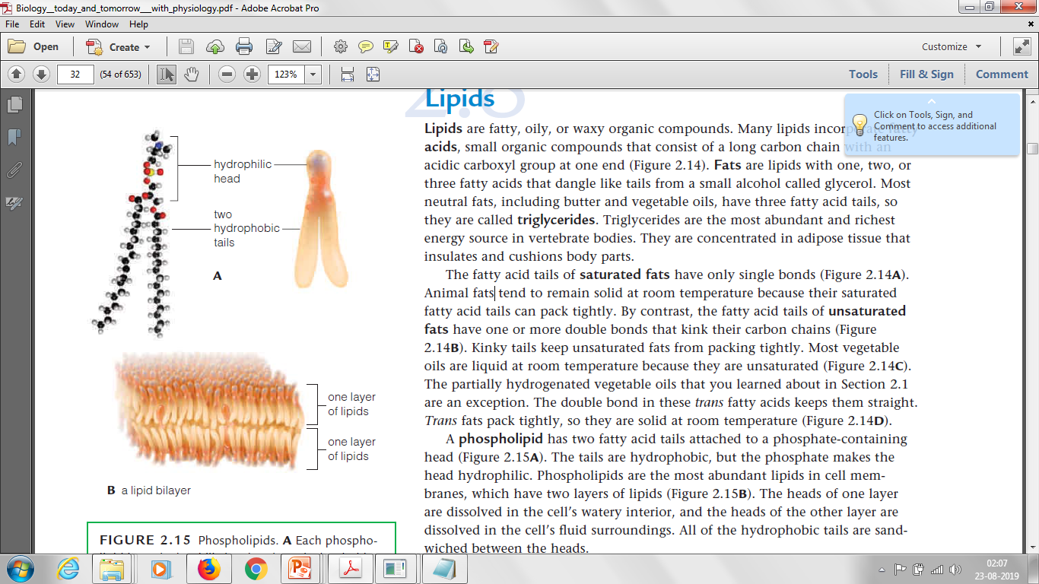
Phospholipids
A phospholipid has two fatty acid tails attached to a phosphate-containing head .
The tails are hydrophobic, but the phosphate makes the head hydrophilic. Hence, they are amphipathic.
Phospholipids are the most abundant lipids in cell membranes, which have two layers of lipids .
The heads of one layer are dissolved in the cell’s watery interior, and the heads of the other layer are dissolved in the cell’s fluid surroundings.
All of the hydrophobic tails are sandwiched between the heads.

Slide 53
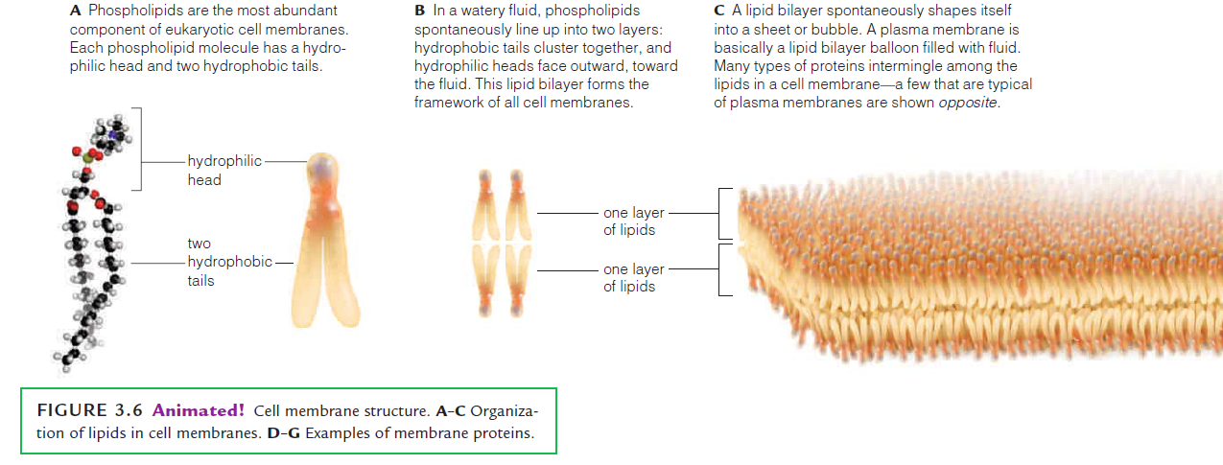
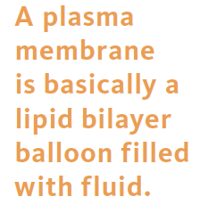
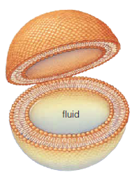
Cell Membranes

Slide 54
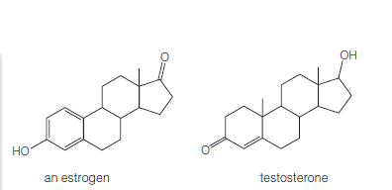
Steroids
Steroids are lipids with a rigid backbone of four carbon rings and no fatty acid tails.
All eukaryotic cell membranes contain them.
Cholesterol, the most common steroid in animal tissue, is also a starting material that cells remodel into many molecules, such as bile salts (which help digest fats) and vitamin D (required to keep teeth and bones strong).
Steroid hormones are also derived from cholesterol.
Estrogens and testosterone, hormones that govern reproduction and secondary sexual traits, are steroid hormones

Slide 55
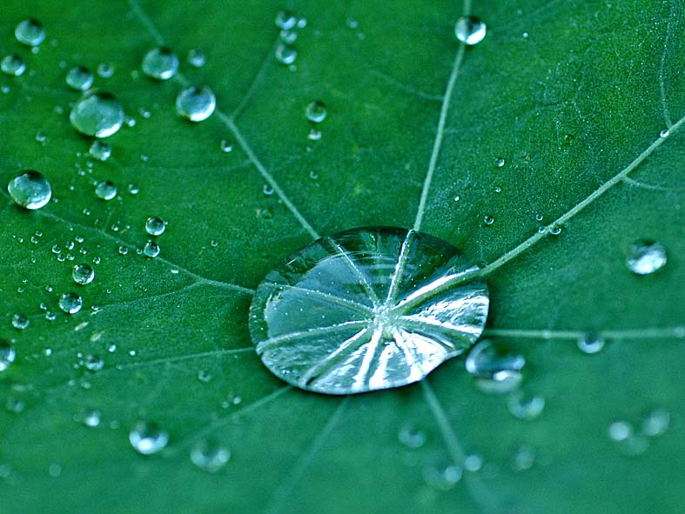
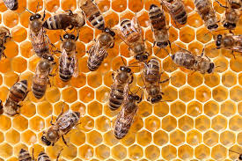
Waxes
Waxes are complex, varying mixtures of lipids with long fatty acid tails bonded to long-chain alcohols or carbon rings.
The molecules pack tightly, so the resulting substance is firm and water-repellent.
Plant cuticle, a layer of secreted waxes, that covers the exposed surfaces of plants helps restrict water loss and keep out parasites and other pests.
Bees store honey and raise new generations of bees inside honeycomb, which they make from beeswax.
Other types of waxes protect, lubricate, and soften skin and hair. Waxes, together with fats and fatty acids, make feathers waterproof.

Slide 56
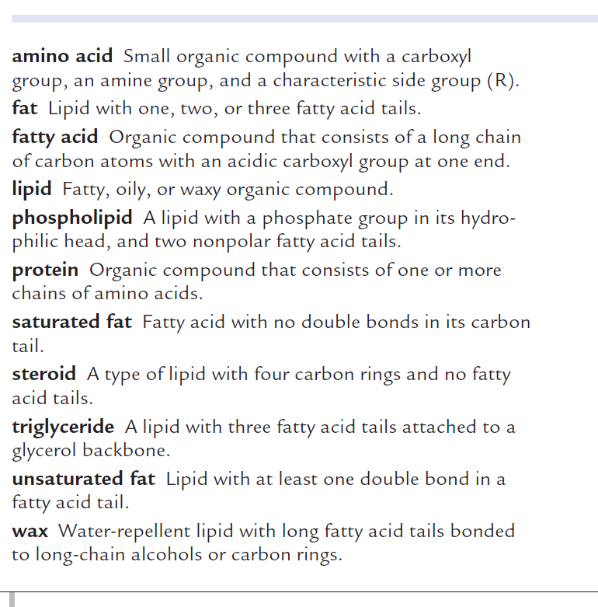
Summary Points

Slide 57
Metabolic pathways for Carbohydrates
The ten pathways/cycles of carbohydrate metabolism are:
Glycolysis
Conversion of Pyruvate to Acetyl COA
Citric Acid Cycle
Gluconeogenesis
Glycogen Metabolism
Glycogenesis
Glycogenolysis
Hexose Monophosphate Shunt
Glyoxylate Cycle and
Photosynthesis.

Slide 58
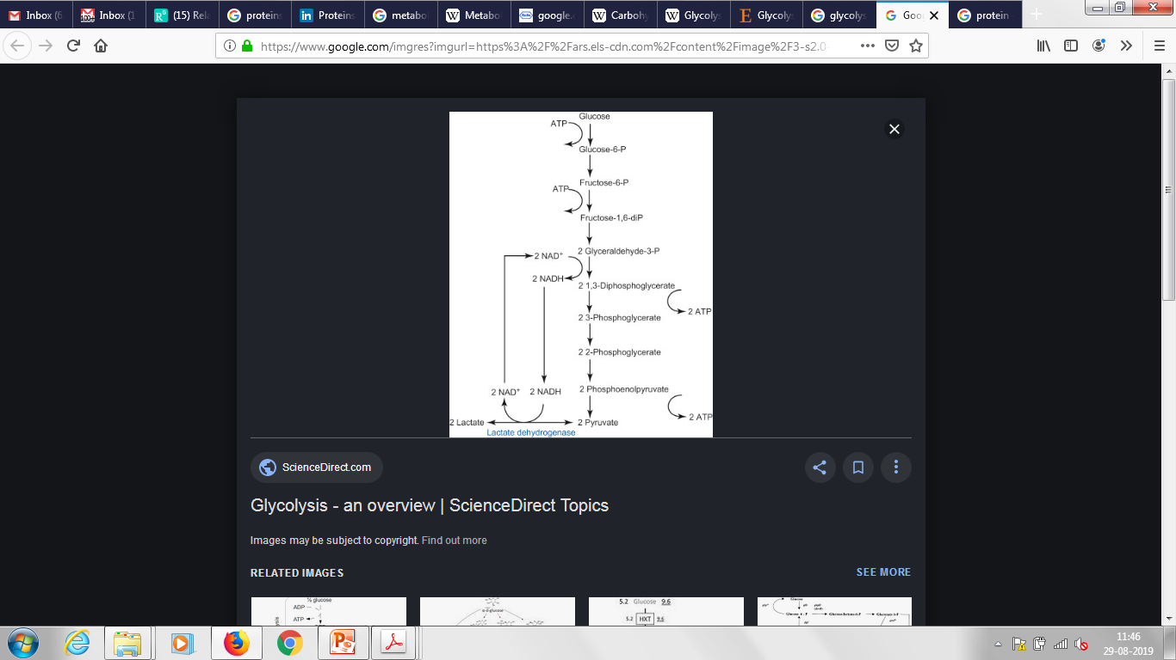
GLYCOLYSIS
Metabolic pathway for breaking down a glucose molecule into two pyruvate molecules.
The free energy released in this process is used to form the high-energy molecules ATP and NADH.
In most organisms, glycolysis occurs in the cytosol.
This pathway is common to both anaerobic and aerobic respiration.
GLUCONEOGENESIS
Reverse process of glycolysis.
Conversion of non-carbohydrate molecules (pyruvate, lactate, glycerol, alanine, and glutamine) into glucose.
Mostly occurs in liver , sometimes in the kidney also.

Slide 59

Citric acid cycle (or Krebs cycle or Tricarboxylic acid-TCA cycle)
Krebs cycle is the most important central pathway connecting almost all the individual metabolic pathways (either directly or indirectly).
Most important metabolic pathway for the energy supply to the body.
About 65-70% of the ATP is synthesized in Krebs cycle.
Citric acid cycle essentially involves the oxidation of acetyl CoA to CO₂ and H₂O.
Final common oxidative pathway for carbohydrates, fats and amino acids.
This cycle not only supplies energy but also provides many intermediates required for the synthesis of amino acids, glucose, heme etc.
The enzymes of TCA cycle are located in mitochondrial matrix, in close proximity to the electron transport chain.

Slide 60
Glycogenesis - Process of synthesizing glycogen.
Occurs primarily in the liver, skeletal muscles, and kidney.
Glycogenolysis - Breakdown of glycogen.
Occurs in liver, muscles, and the kidney.

Slide 61
Proteins

Slide 62

What are Proteins?
Proteins are the most abundant biological macromolecules and perform important functions in essentially all biological processes.
Of all biological molecules, proteins are the most diverse.
They perform a wide range of functions such as,
catalysing metabolic reactions,
transporting and storing molecules,
providing mechanical support and immune protection,
transmitting nerve impulses, and
controlling growth and differentiation.
**Proteins are translated from RNAs

Slide 63


Slide 64

Some examples of Proteins
Spiderwebs, feathers, hooves, and hair, as well as bones and other body parts consist mainly of structural proteins.
Foods such as seeds and eggs are nutritious in part because they are high in protein.
Most enzymes are proteins.
The action of the immune system is mediated by another class of proteins called antibodies.

Slide 65

Monomers of Proteins?
Amino acid
Proteins are linear polymers of amino acid residues that are joined together by a specific type of covalent bond.
There are twenty different amino acids that are commonly found in proteins and all of them are α-amino acids.
Cells can make thousands of different kinds of proteins from only 20 kinds of amino acids.

Slide 66

Zwitterions
Amino acids in solution at neutral pH exist mostly as dipolar ions (also called zwitterions).
In the dipolar form, the amino group is protonated (-NH3+) and the carboxyl group is deprotonated (-COO-).
A zwitterion can act as either an acid (proton donor) or a base (proton acceptor).

Slide 67

Amino acids
Source: Lehninger

Slide 68


Peptide Bond
Amino acids can form bonds with each other by linking the α-carboxyl group of one amino acid to the α-amino group of another amino acid with a peptide bond.
This is accompanied by the loss of a water molecule.
A number of amino acids are joined together by the peptide bonds to form a polypeptide chain.
Each amino acid unit in a polypeptide is called a residue.
Peptide bond

Slide 69


Proteins are made up of L-aa
L-Amino acids are those with the -amino group on the left, and D-amino acids have the -amino group on the right.

Slide 70


Polar/ hydrophilic nature of peptide bond

Slide 71





Regions of polypeptide chain can take a helical or sheet like structures
β-sheet
There are 3.6 residues/turn in an α-helix

Slide 72

H-bonds between atoms of peptide backbone plays important role in protein folding

Slide 73

Four noncovalent interaction helps protein to fold
H-bond
Electrostatic interaction
Van der Waals attraction
Hydrophobic interaction

Slide 74

Hydrophobic interactions

Slide 75

Disulfide bond have a major stabilizing effect on protein
As energy required to break one covalent bond is much larger than the energy required to break even a whole set of non-covalent bonds, a disulfide bond have a major stabilizing effect on a protein.

Slide 76

Protein structure hierarchy
Primary structure: It is the linear arrangement of amino acid residues in a protein describing all covalent bonds (mainly peptide bonds and disulphide bonds). The most important element of primary structure is the sequence of amino acid residues.

Slide 77

Protein structure hierarchy…
2. Secondary structure: It is the stable arrangement of amino acid residues giving rise to recurring structural patterns (referring to the local conformation). These are stabilized by hydrogen bonds. The examples include the
alpha (α) helices: The amino acids in an α helix are arranged in a right-handed helical structure, and the side chains of the amino acid residues protrude outward from the helical backbone.
beta (β) pleated sheets: The β pleated sheet consists of β strands that are held together by H-bonds. The strands of a β pleated sheet may be parallel, pointing in the same direction (both N- and C-termini are in same direction), or antiparallel, pointing in opposite directions (N-terminus of one strand is positioned next to the C-terminus of the other).

Slide 78
Protein structure hierarchy…
3. Tertiary structure: The overall 3D arrangement of all the atoms in a protein, which results from a large number of non-covalent interactions between the atoms, is known as the tertiary structure.
4. Quaternary structure: The arrangement of multiple polypeptides in 3D complexes constitutes quaternary structure. Each polypeptide chain in the complex is called subunit and they are stabilized by the non-covalent interactions. A typical example of a quaternary structure is haemoglobin that consists of two alpha globin and two beta globin subunits.
Structure of haemoglobin protein

Slide 79

Structure of a protein is important for its function

Slide 80

Protein can be of varied shape and size

Slide 81


Protein denaturation
The shape depends on many hydrogen bonds and other interactions that heat, shifts in pH, or detergents can disrupt.
At such times, proteins denature, which means they unwind and otherwise lose their three-dimensional shape. Once a protein’s shape unravels, so does its function.

Slide 82


Change in protein structure can be detrimental

Slide 83


Prion disease
Prions are misfolded proteins with the ability to transmit their misfolded shape onto normal variants of the same protein.
They characterize several fatal and transmissible neurodegenerative diseases in humans and many other animals

Slide 84

Summary Points

Slide 85
Nucleic Acids

Slide 86

Nucleic Acids
Genetic material is comprised of the nucleic acids, DNA and RNA.
Deoxyribonucleic acid (DNA) is the carrier of genetic information, while ribonucleic acid (RNA) plays a role in using the information contained within the DNA to make new molecules in the cell.
Some viruses use RNA as their genetic material instead of DNA.

Slide 87

Monomers of Nucleic Acids ?
Nucleotide
Nucleic acids are chains of nucleotides in which the sugar of one nucleotide is joined to the phosphate group of the next.

Slide 88


Basic structure of nucleotides

Slide 89


Nucleotides have diverse function
1. Subunits of DNA and RNA.
The molecular repositories of genetic information.

Slide 90

Nucleotides have diverse function
2. Energy carriers
3. Enzyme helpers
4. Chemical messengers

Slide 91


The three components of nucleotides
Nitrogenous Bases
Phosphates
Sugar
C₅H₁₀O₄
C₅H₁₀O₅

Slide 92

Phosphodiester Bonds Link Successive Nucleotides in Nucleic Acids
Nucleotide 1
Nucleotide 2
Successive nucleotides of both DNA and RNA are covalently linked through phosphate group “bridges,” in which the 5-phosphate group of one nucleotide unit is joined to the 3-hydroxyl group of the next nucleotide, creating a phosphodiester linkage .

Slide 93

Phosphodiester bond and chemical properties of nucleic acids
The backbones of nucleic acid are hydrophilic. The hydroxyl groups of the sugar residues form hydrogen bonds with water.
Phosphate groups are completely ionized and negatively charged at pH 7, and the negative charges are generally neutralized by ionic interactions with positive charges on proteins, metal ions, etc.

Slide 94




Watson-Crick model for the structure of DNA

Slide 95


Slide 96


Slide 97


Slide 98

Double stranded DNA and DNA double helix
4 bases in DNA
A: Adenine G: Guanine
T : Thymine C: Cytosine
Complementarity

Slide 99

Ribonucleic acid (RNA)
Single stranded
Ribose sugar instead of deoxyribose
U: Uracil instead of T

Slide 100
DNA vs RNA (only key differences)
Comparison | DNA | RNA
Full Name | Deoxyribonucleic Acid | Ribonucleic Acid
Structure | DNA consists of two strands, arranged in a double helix. | RNA only has one strand
Sugar | The sugar in DNA is deoxyribose, which contains one less hydroxyl group than RNA’s ribose. | RNA contains ribose sugar molecules
Bases | The bases in DNA are Adenine (‘A’), Guanine (‘G’) Cytosine (‘C’) and Thymine (‘T’). | RNA shares Adenine (‘A’), Guanine (‘G’) and Cytosine (‘C’) and Uracil (‘U’).
Base Pairs | Adenine and Thymine pair (A-T) Cytosine and Guanine pair (C-G) | Adenine and Uracil pair (A-U) Cytosine and Guanine pair (C-G)
Location | DNA is found in the nucleus, with a small amount of DNA also present in mitochondria. | RNA forms in the nucleolus, and then moves to specialised regions of the cytoplasm depending on the type of RNA formed.
Function | DNA replicates and stores genetic information. It is a blueprint for all genetic information contained within an organism | RNA converts the genetic information contained within DNA to a format used to build proteins.

Slide 101

Summary

Slide 102

Elements in the 4 macromolecules
S

